Slide 1
Homework 4 (Discussion)
Plot a map to show the Taiwan coastline
Superimpose two drifter trajectories near to Taiwan (within 500 km) on the map.

Slide 2
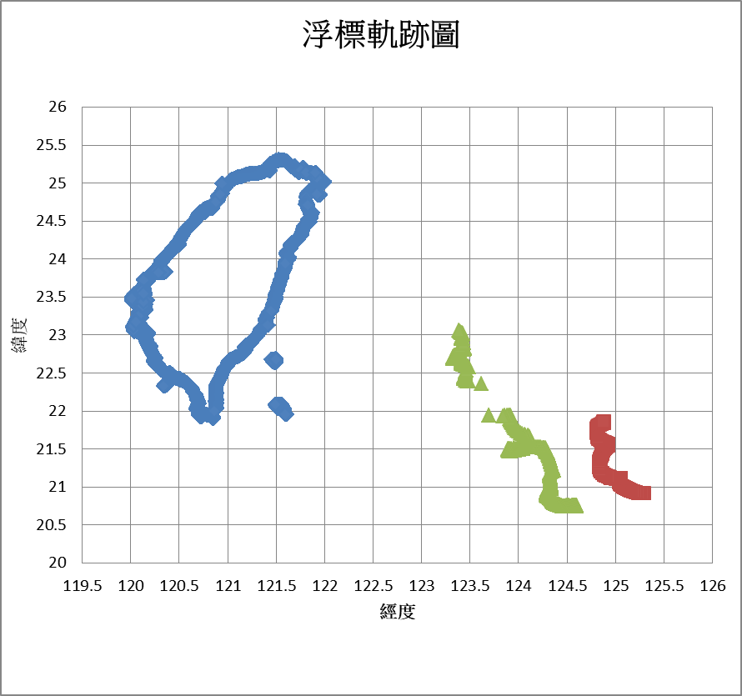

Slide 3
Drifter Analysis
Using drifters to study
Ocean Currents

Slide 4
分組討論
Try to google and discuss:
How do we use drifters to study ocean currents?
What knowledge of ocean currents we can learn from the drifter observation ?
分組3~4人, 用筆紙寫下討論結果後交上(註明姓名), 上臺報告

Slide 5
Outline
Using drifter trajectories (軌跡) to study ocean currents
Using drifter speeds (速率) to study ocean currents

Slide 6

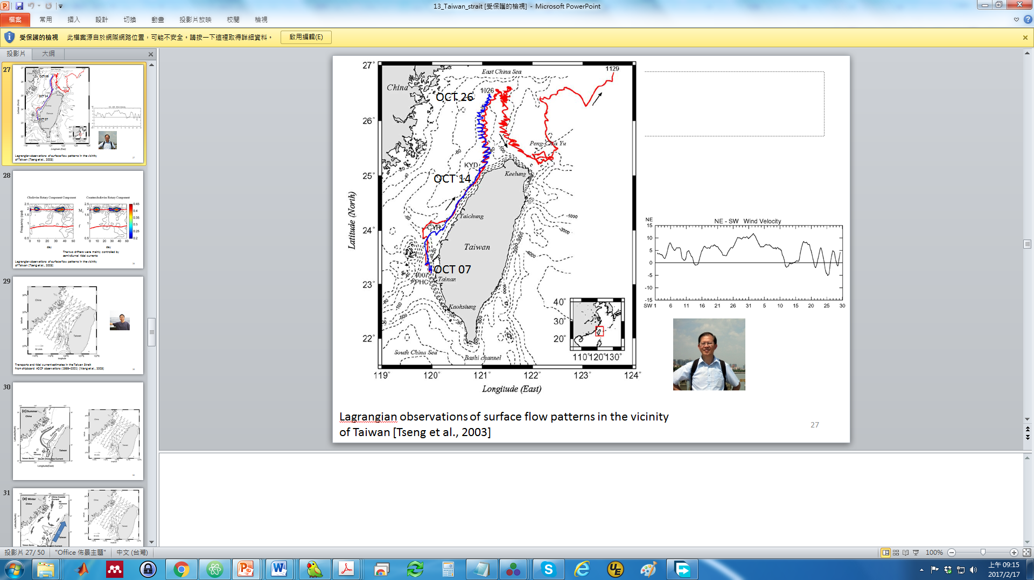



Drifter Specialists
Jian-Hwa Hu
Ruo-Shan Tseng
Peter Niiler (1937~2010)
LUCA CENTURIONI
Rick Lumpkin

Slide 7
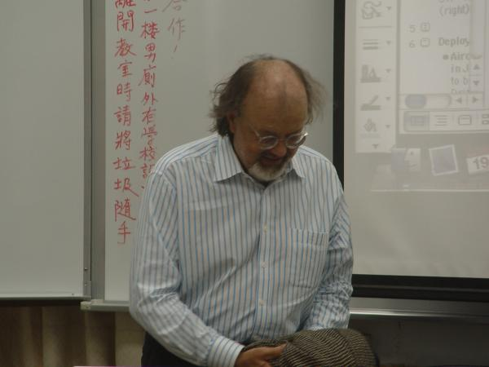
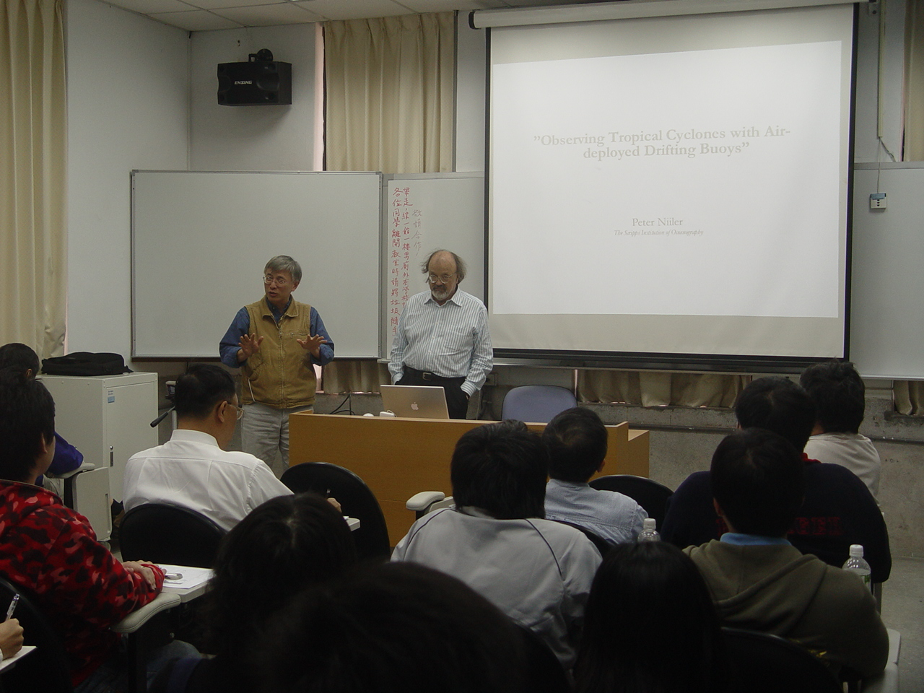
2008 March 20

Slide 8
Using drifter trajectories to study ocean currents

Slide 9
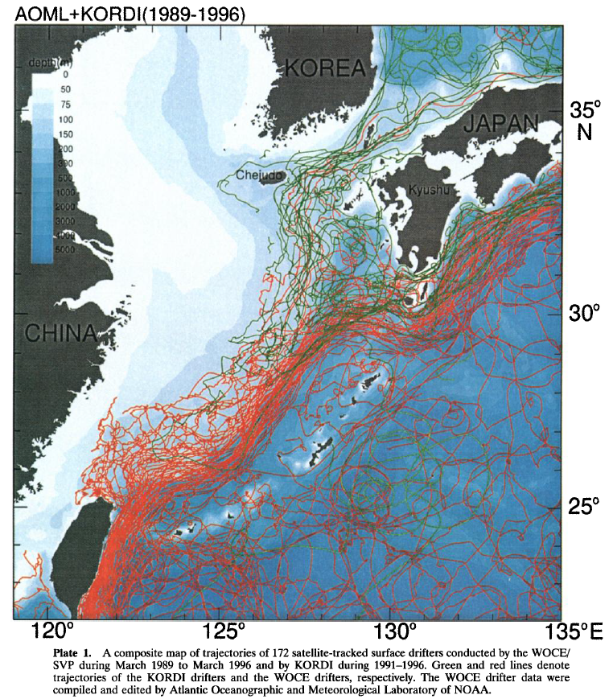
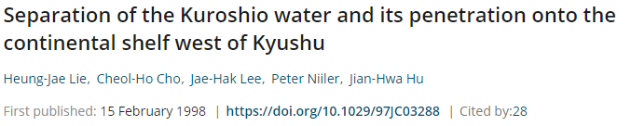

Slide 10
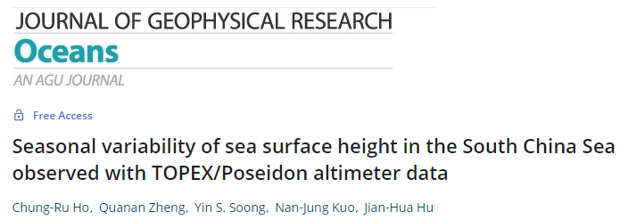
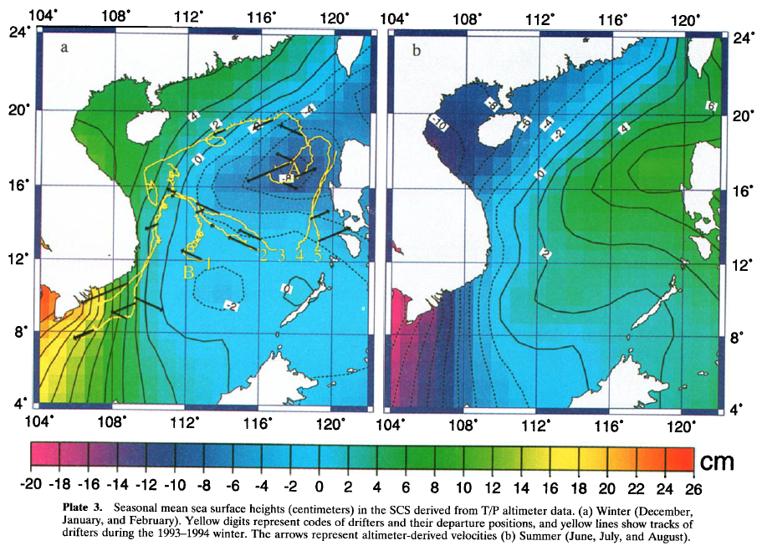

Slide 12
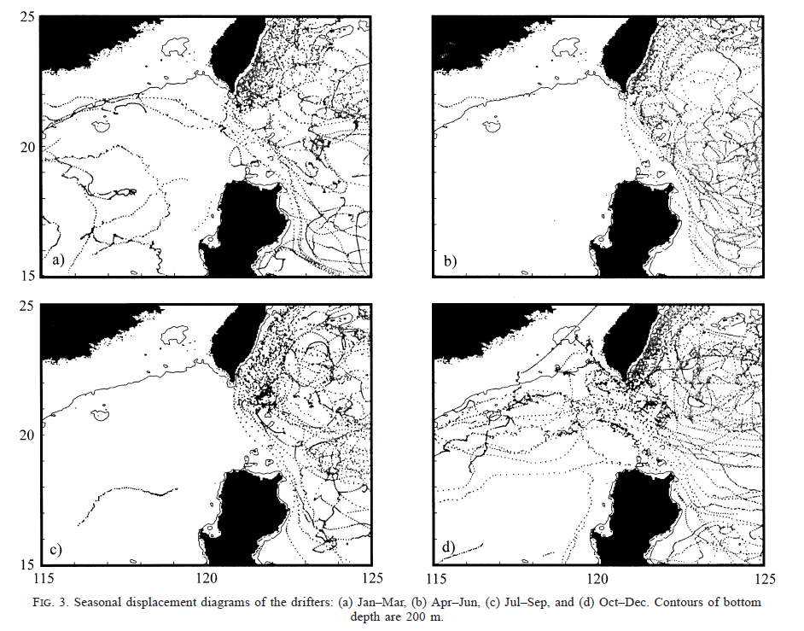
Photo Hunt (大家來找碴)
Observations of Inflow of Philippine Sea Surface Water into the South China Sea through the Luzon Strait (LUCA R. CENTURIONI AND PEARN P. NIILER)

Slide 13
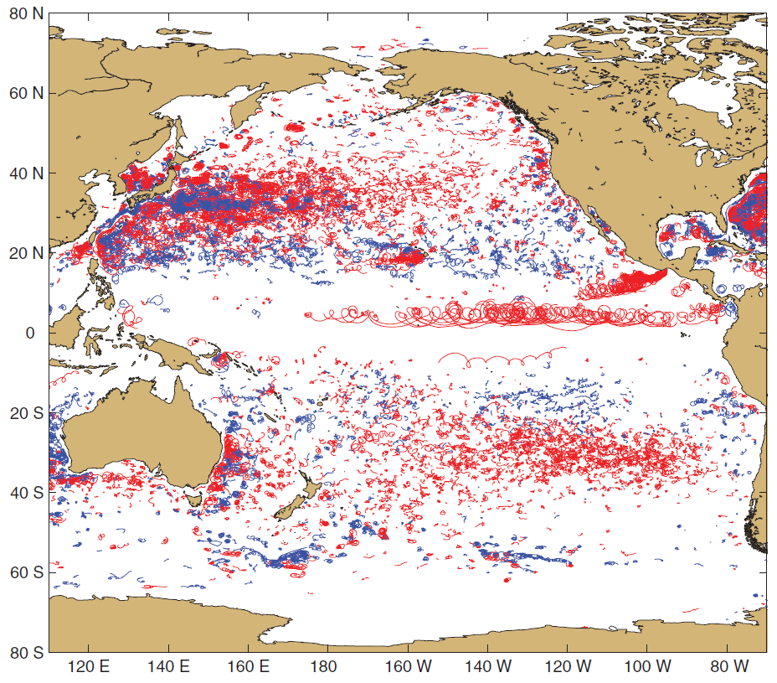

Trajectories of cyclonic (blue) and anticyclonic (red) loopers identified in the drifter data.
Lumpkin, R. (2016), Global characteristics of coherent vortices from surface drifter trajectories,
J. Geophys. Res. Oceans, 121, 1306–1321, doi:10.1002/2015JC011435.

Slide 14

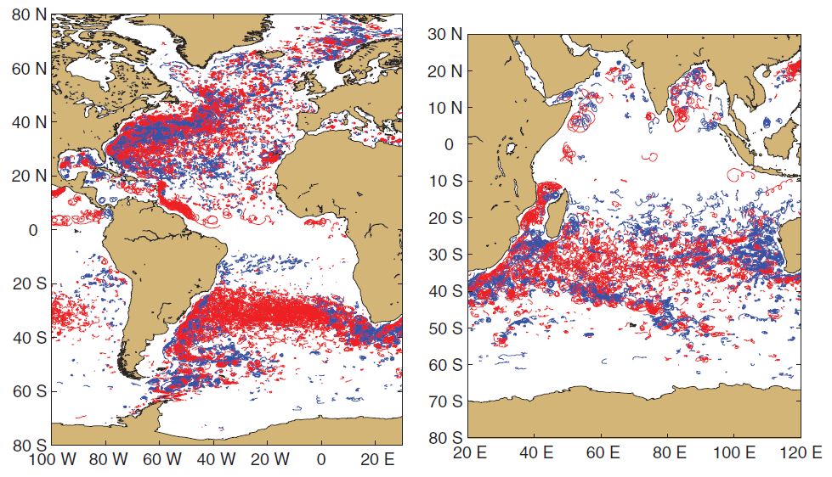
Lumpkin, R. (2016), Global characteristics of coherent vortices from surface drifter trajectories,
J. Geophys. Res. Oceans, 121, 1306–1321, doi:10.1002/2015JC011435.

Slide 15
Using drifter speeds to study ocean currents

Slide 16
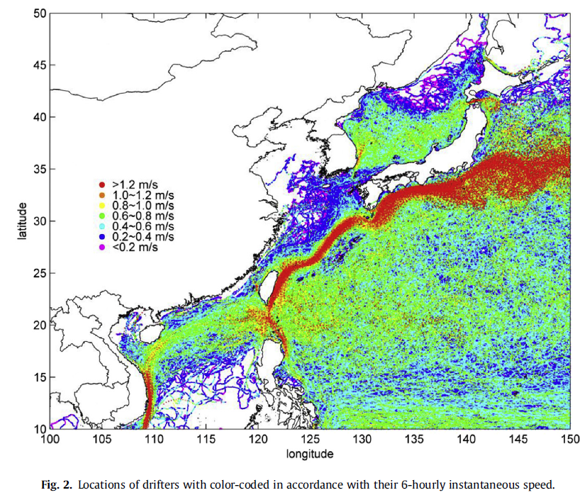
Site selection of ocean current power generation from drifter
Measurements (Yu-Chia Chang, Peter C. Chu, Ruo-Shan Tseng)

Slide 17
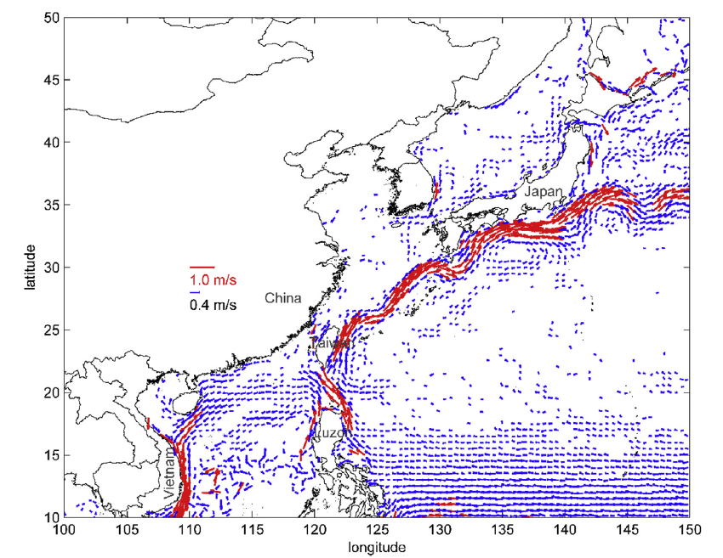
Site selection of ocean current power generation from drifter
Measurements (Yu-Chia Chang, Peter C. Chu, Ruo-Shan Tseng)

Slide 18
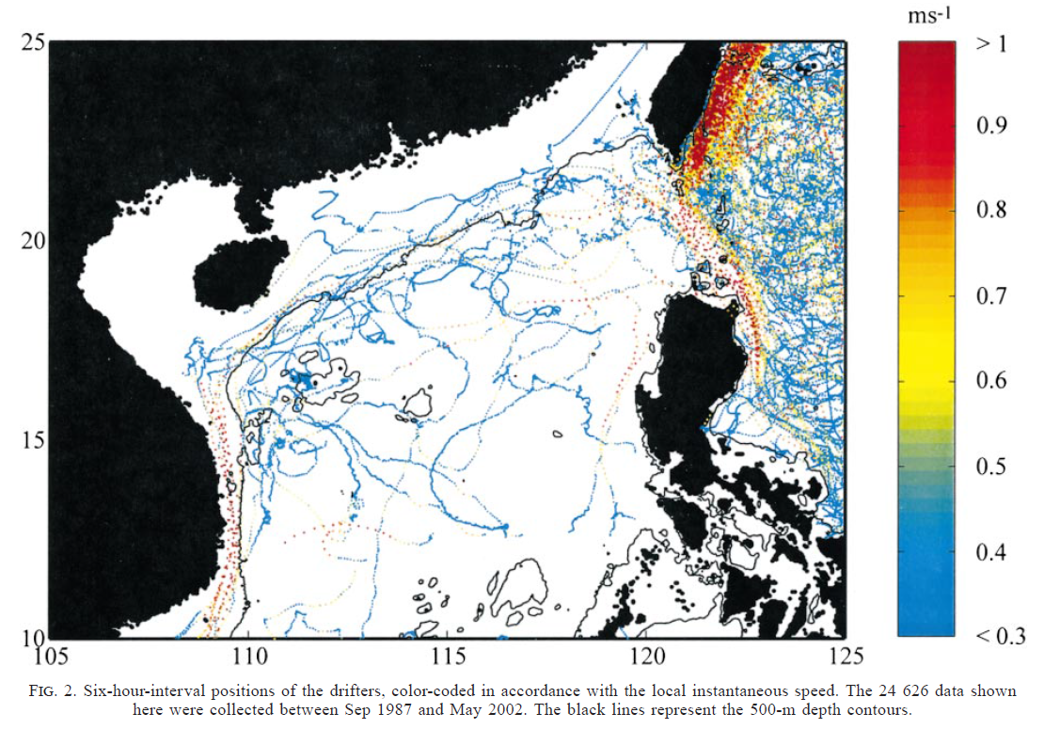
Observations of Inflow of Philippine Sea Surface Water into the South China Sea through the Luzon Strait (LUCA R. CENTURIONI AND PEARN P. NIILER)

Slide 19
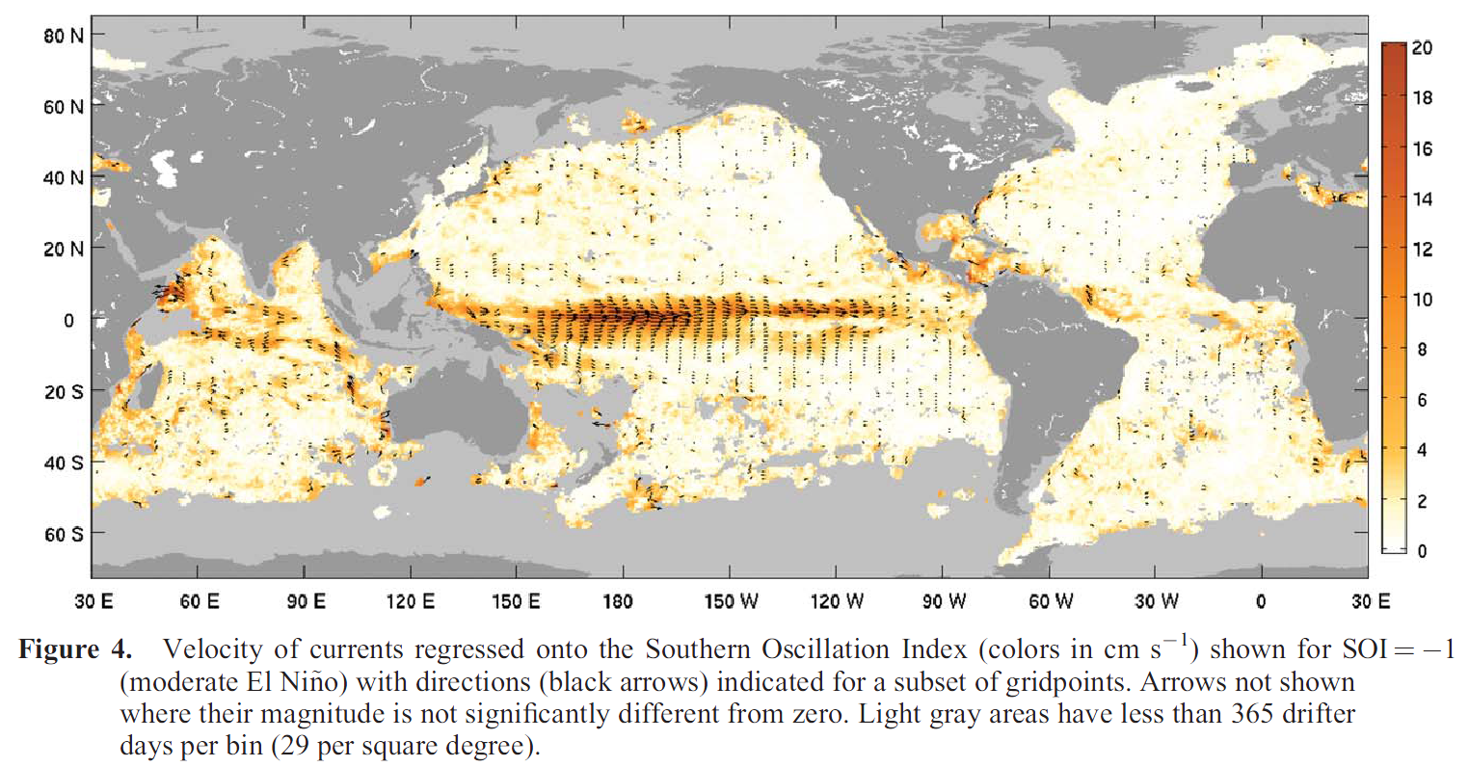
Lumpkin, R., and G. C. Johnson (2013), Global ocean surface velocities from drifters : Mean, variance, El Nino–Southern Oscillation response, and seasonal cycle, J. Geophys. Res. Oceans, 118, 2992–3006, doi:10.1002/jgrc.20210.

Slide 20
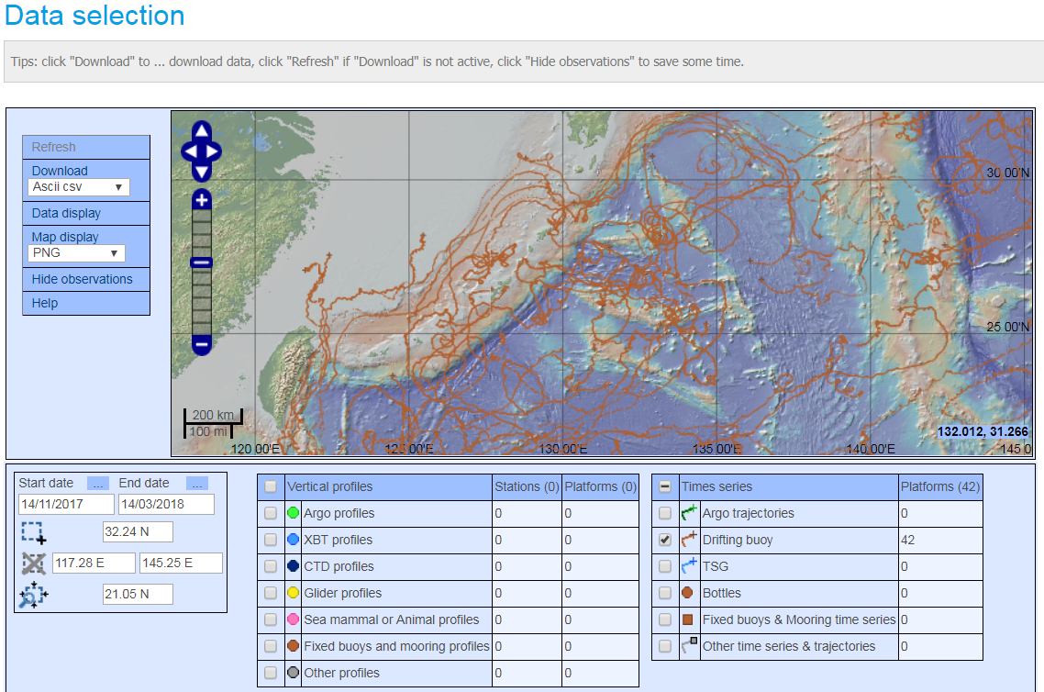
Drifter data (coriolis)
http://www.coriolis.eu.org/Data-Products/Data-Delivery/Data-selection

Slide 21
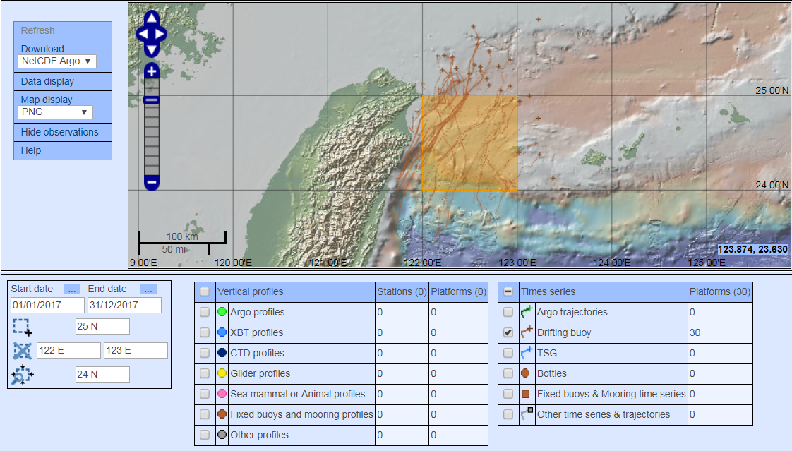
Taiwan_2017.txt

Slide 22
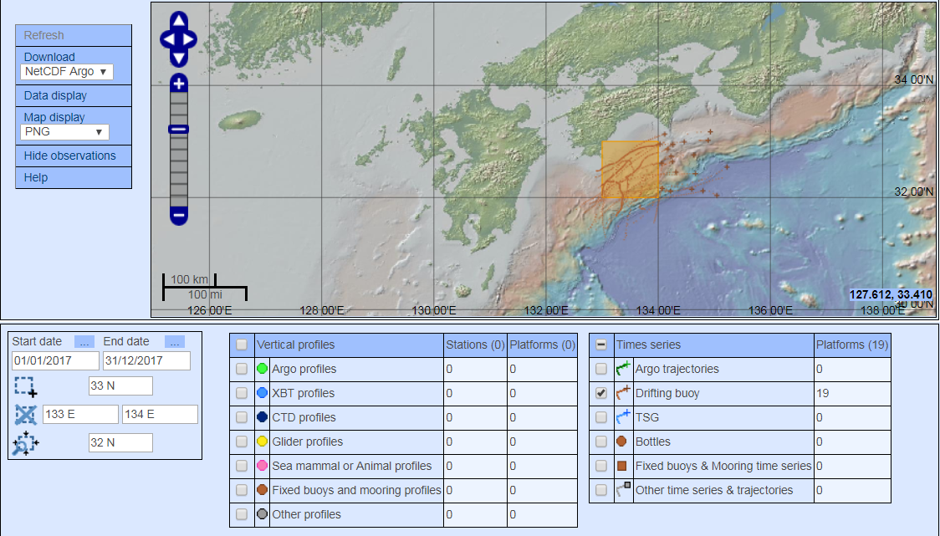
Japan_2017.txt

Slide 23
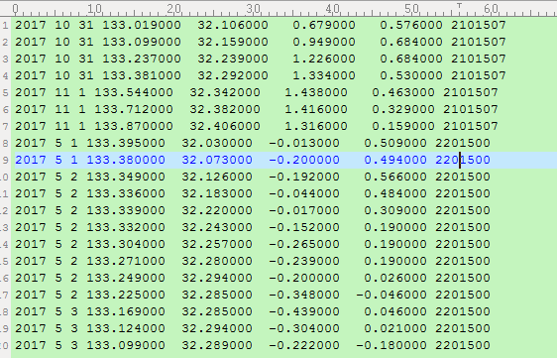
Drifter data on the tronclass server
Taiwan_2017.txt
Japan_2017.txt
[Year Month Date longitude latitude u-velocity v-velocity ID]

Slide 24
Exercise in class
Using the drifter data given in the txt files on the tronclass system, calculate the total mean speed of Kuroshio in each region, east of Taiwan and south of Japan, in 2017.
Which location has faster and slower speed of Kuroshio in 2017?
Calculate the monthly average of Kuroshio speed in these regions during July and December, 2017. Then, show the results in a graph to compare the Kuroshio speed in these regions during July and December, 2017.

Slide 25
Discussion First
What we need to do first?
Think and start planning how to solve this?
Using the drifter data given in the txt files on the tronclass system, calculate the total mean speed of Kuroshio in each region, east of Taiwan and south of Japan, in 2017.

Slide 26
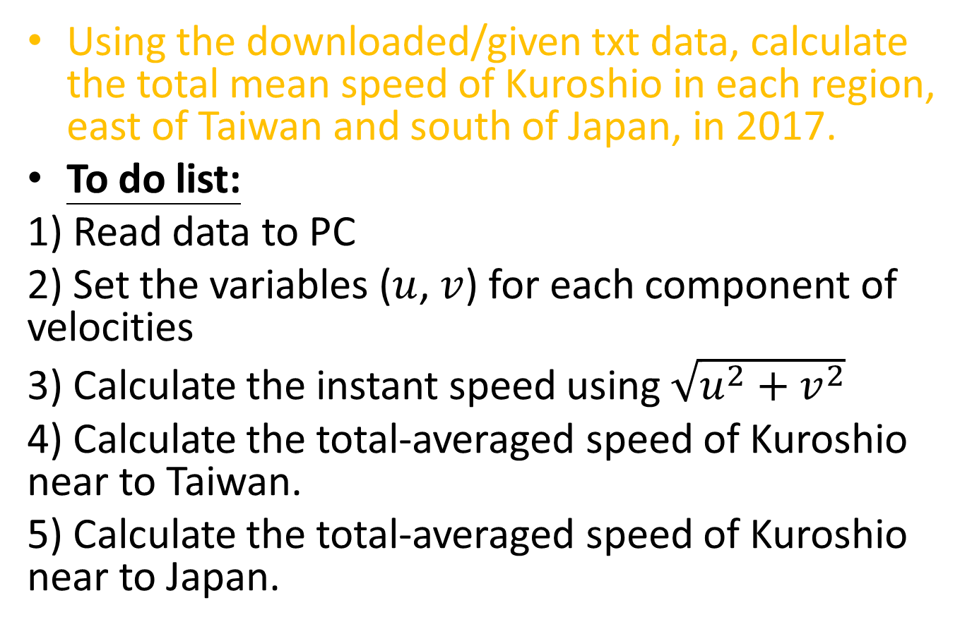
Exercise in class
Using the downloaded/given txt data, calculate the total mean speed of Kuroshio in each region, east of Taiwan and south of Japan, in 2017.
To do list:
1) Read data to PC
2) Set the variables ($u$, $v$) for each component of velocities
3) Calculate the instant speed using $\sqrt{{u^{2}+v}^{2}}$
4) Calculate the total-averaged speed of Kuroshio near to Taiwan.
5) Calculate the total-averaged speed of Kuroshio near to Japan.

Slide 27
Exercise in class
Which location has faster and slower speed of Kuroshio in 2017?
To do list:
1) Compare the averaged speed of Kuroshio near to Taiwan and Japan.

Slide 28
Discussion First
What we need to do first?
Think and start planning how to solve this?
Calculate the monthly average of Kuroshio speed in these regions during July and December, 2017. Then, show the results in a graph to compare the Kuroshio speed in these regions during July and December, 2017.

Slide 29
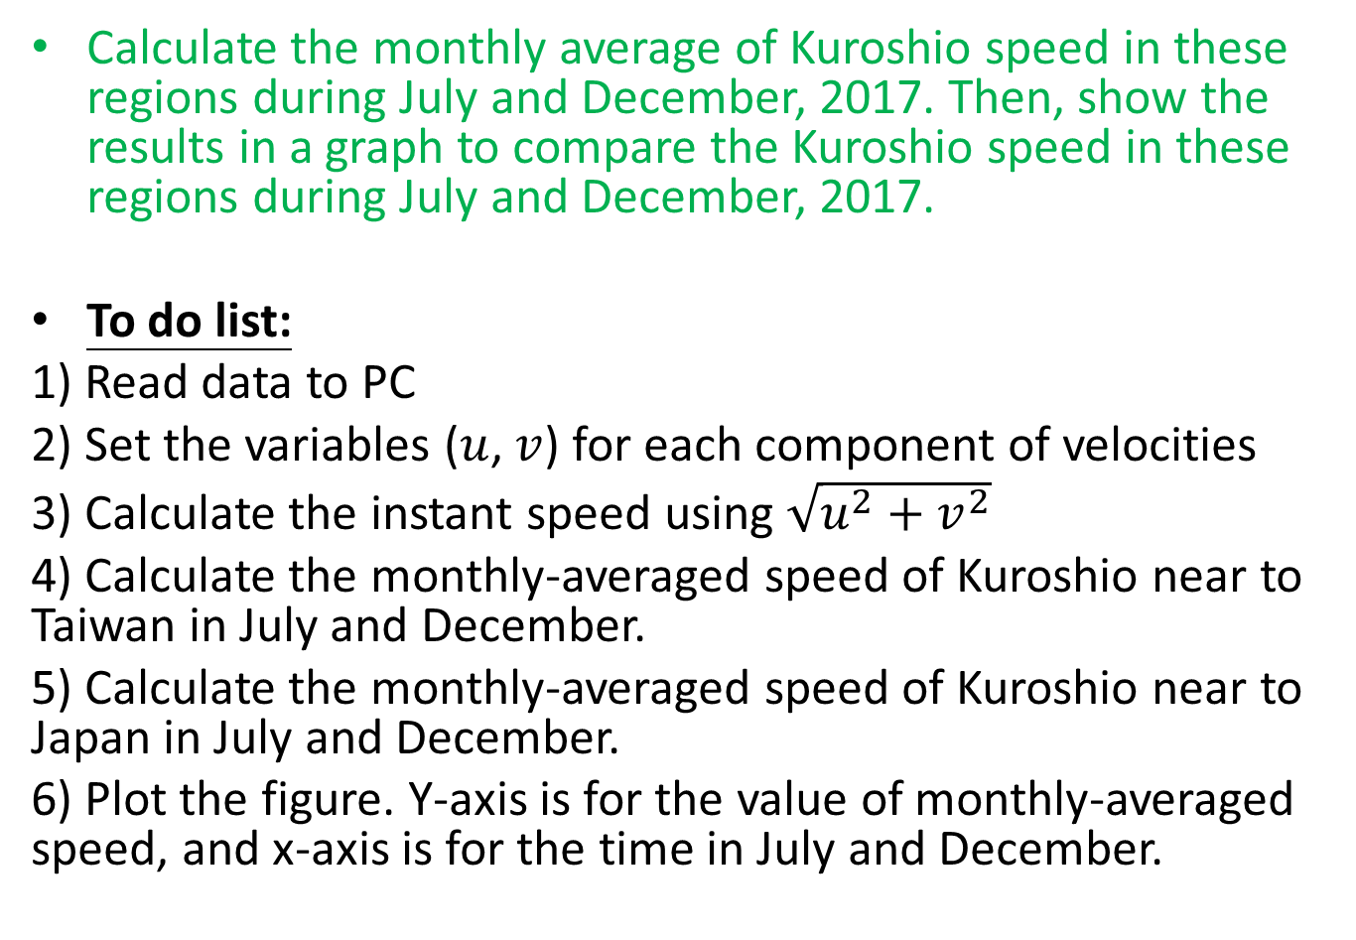
Exercise in class
Calculate the monthly average of Kuroshio speed in these regions during July and December, 2017. Then, show the results in a graph to compare the Kuroshio speed in these regions during July and December, 2017.
To do list:
1) Read data to PC
2) Set the variables ($u$, $v$) for each component of velocities
3) Calculate the instant speed using $\sqrt{{u^{2}+v}^{2}}$
4) Calculate the monthly-averaged speed of Kuroshio near to Taiwan in July and December.
5) Calculate the monthly-averaged speed of Kuroshio near to Japan in July and December.
6) Plot the figure. Y-axis is for the value of monthly-averaged speed, and x-axis is for the time in July and December.

Slide 30
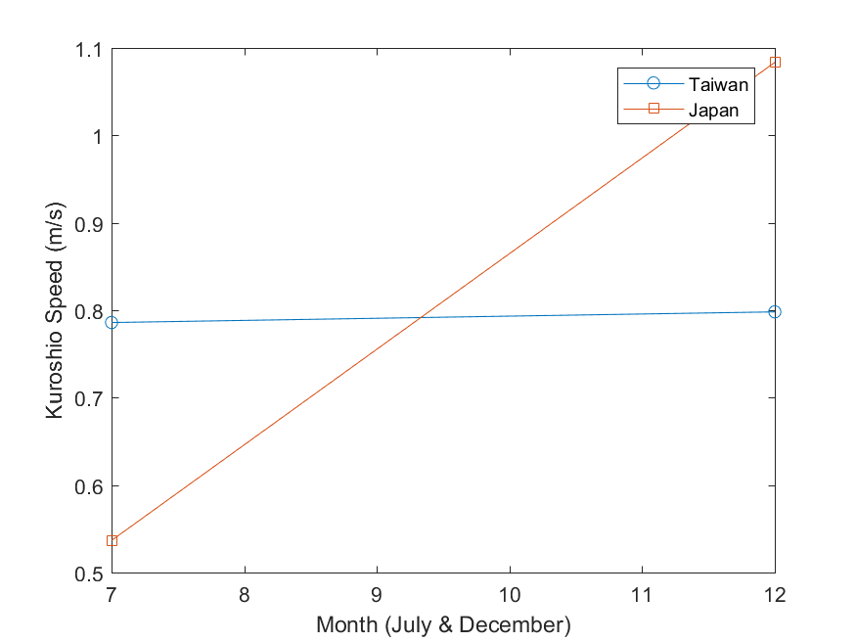

Slide 31
分組任務競賽 (30 mins, if still have time, bonus for 1st accomplished group: 3%)
Find out a drifter trajectory that was near to a typhoon track. Calculate the mean speed of the drifter during the typhoon period.
Show a figure with the typhoon track and dates.
Show the drifter trajectory and the mean speed of the drifter.

Slide 32
Homework 5 (繳交期限: 2019/04/17) 遲交以50%計算
Compare the pattern of Kuroshio pathway in the periods from 1st November 2015 to 28th March 2016 and from 1st November 2017 to 28th March 2018. (Hint: using drifter trajectories to study the Kuroshio)
Try to google how we human firstly discovered ocean currents. (我們人類最早是怎樣發現洋流的?)
Send your work in a docx word file (filename: hw05_yourname.docx)
to https://driveuploader.com/upload/lVD4ycOKfP/

